Slide 1
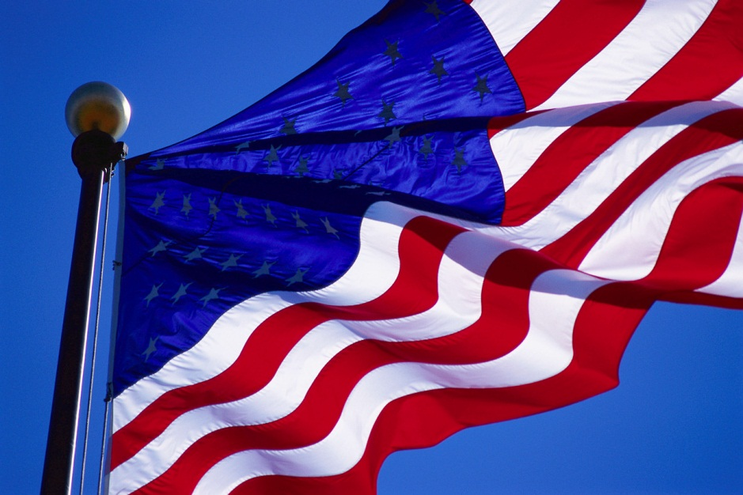
Unleash American Business

Slide 2
Unleash American Business
  When you think of America
    Land of Opportunity
    Freedom to innovate
    Entrepreneurial spirit

Slide 3
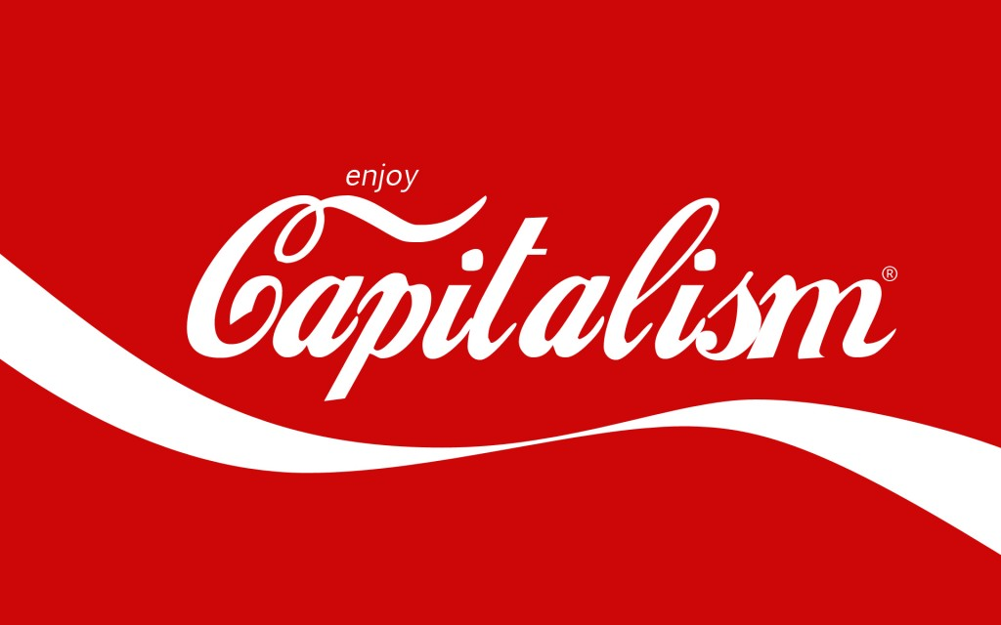
Unleash American Business
Capitalism works when
  Level playing field
  Regulation is reasonable
  Room to maneuver

Slide 4
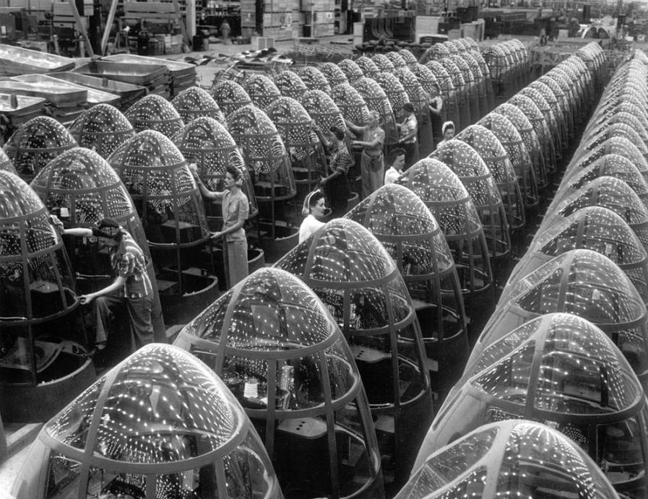
Unleash American Business
Health Care and American Business
  WW II wage controls
  When health care was simple and cheap
  Benefits now wagging the dog

Slide 5
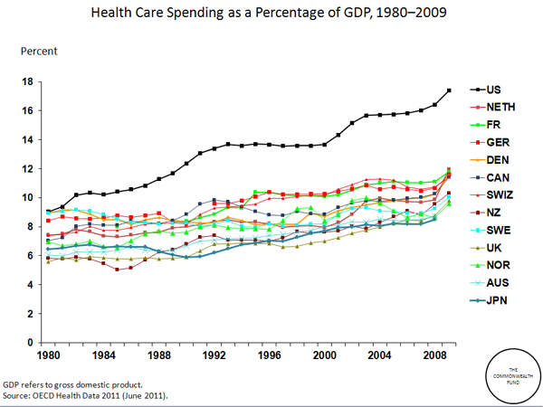
Unleash American Business
Health Care costs out of control
  18% of GDP and rising
  Distortion of business expense
  Poor Quality and Access

Slide 6
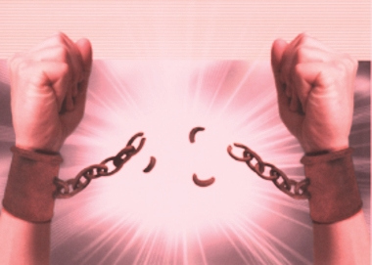
Unleash American Business
Two problems, One solution
  Decouple health care finance from business
  Promote Medicare for All
  Get back to work

Slide 7

Unleash American Business
Why Decouple and Promote?
  The business of business is business
  All other nations pick up the cost
  As long as there is a hole money flows like water
  Healthy employees are productive

Slide 8

Unleash American Business
How would Medicare for All work
  Redirect current spending – no new funds needed
  All medically necessary from licensed providers
  What about Death Panels? – Same as current

Slide 9
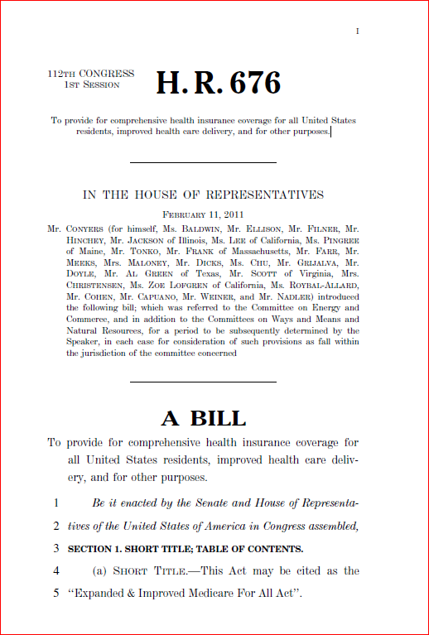

Unleash American Business
What you can do today
  Support HR 676
  Partner with PNHP
  Get back to work

