Slide 1
Why Obamacare isn’t enough
The case for Single Payer
David S. Ball RN, MHA
Co-Founder
Healthcare for All -SC

Slide 2

Time for a quiz (True or False)

Slide 3
Why Obamacare isn’t enough
America has the best healthcare in the world.
Nothing can be done about healthcare costs.
Government takeover of healthcare gets between you and your doctor.
Hospitals are required to provide medical care to anyone in the Emergency Department.

Slide 4
Why Obamacare isn’t enough
Government is wasteful/ Free market is efficient.
Unemployment is the choice of freeloaders.
Everyone doesn’t need health insurance.
We can’t afford to fund Medicare.

Slide 5
Attributes of Healthcare
Access
Quality
Cost

Slide 6
Why Obamacare is Good
There has been no requirement that employers or insurance companies accept anyone – until now.
Insurers could deny coverage due to preexisting conditions – until now.
Dependents could be dropped from their parent’s plan before age 26 – until now.

Slide 7
Why Obamacare is Good (more)
Significantly expands coverage to the poor through state-federal Medicaid program.
Creates publicly administered health insurance exchanges.
Exchange plans must accept everyone and cannot set premiums based on health status.
Limits administrative percentage for insurers.

Slide 8

Middle of the road approach

Slide 9
Why Obamacare is Bad
Continued for-profit health insurance likely to frustrate efforts to control health care costs.
26 million people will remain uninsured in 2016.
Most effective way to control costs is government negotiation with providers, including hospitals and pharmaceutical corporations. Done by Medicare and VA, not by Obamacare.

Slide 10
Why Obamacare is Bad (more)
Exchanges only offer private plans, no public option or chance to buy into Medicare.
45,000 will die this year because they lack health insurance.
Obamacare moves Single Payer back years.

Slide 11
Can this be true?
People deserve only the health care they can pay for individually.
Government authority = tyranny.
  Whether used to compel individual contributions
  to pay for health care or to set health care prices.

Slide 12
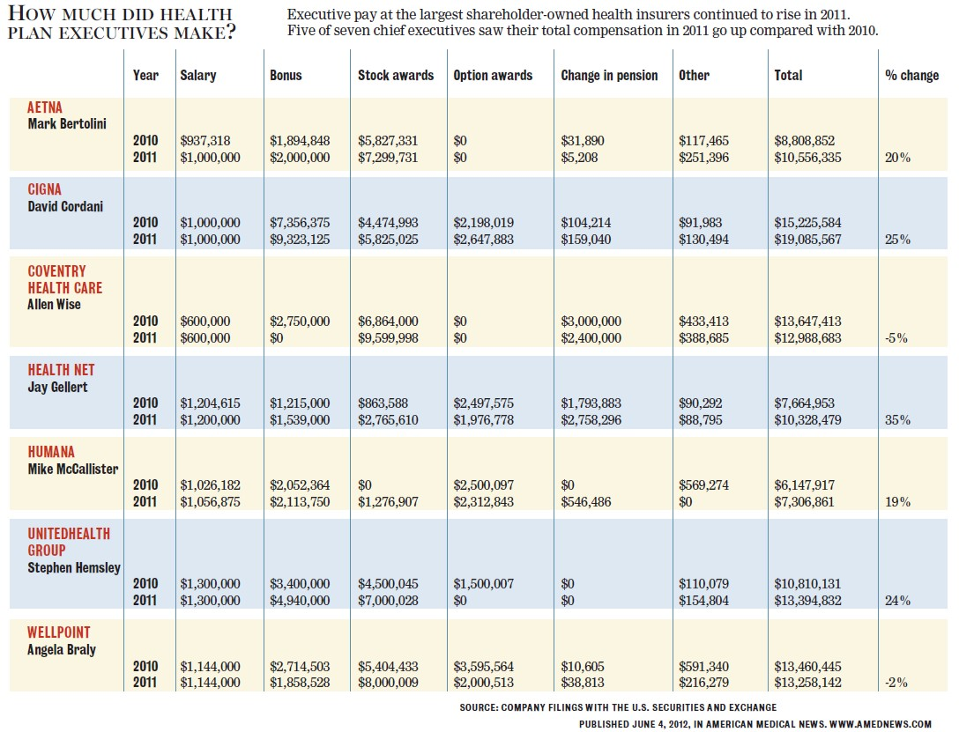
How can we save $86,918,899?

Slide 13
Health care insurance math
$86,918,899 = X
30%
X = $289,729,663
CEO compensation for 7 people requires spending over a quarter of a billion dollars*.
*(assumes only expenses are CEO compensation and there are only 7 people)

Slide 14
Did you know this about Medicare?
Since Medicare began, solvency projection has ranged from 2-28 years (average 11.3). It is currently 13.
Due to health care reform, Medicare’s unfunded obligation over the next 75 years declined from $13.5 trillion to $3 trillion.
Medicare is an earned entitlement.
Medicare funds the vast majority of residency training in the US.

Slide 15
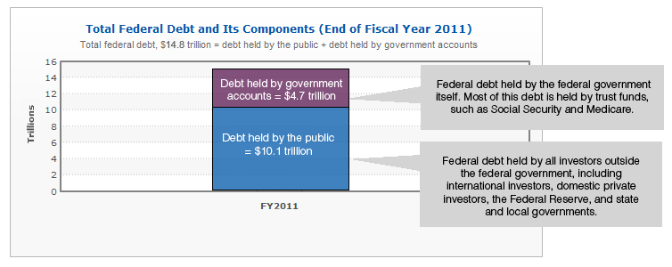
How does Medicare relate to debt?

Slide 16
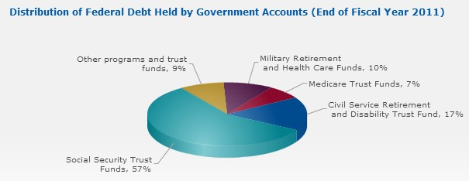
Medicare funds held in Trust

Slide 17
How to fix Medicare
Everybody in, nobody out
Stop raiding Trust fund
Establish global budgets
Negotiate drug prices
Research what works
Remove profit from financing

Slide 18

www.pnhpSC.org

Slide 19
Questions? Comments?

